Slide 1
CS6461 – Computer Architecture
Lecture 1 – Introduction
Adopted from Professor Stephen H. Kaisler’s Slides

Slide 2
Introduction
"Students of computer architecture all too frequently see the microprocessor in the light of the latest high-performance personal computer. For many of them, there is no past—the computer suddenly burst onto the scene as if it had fallen through a time warp. In reality, the computer has a rich and complex history.“
A. Clement
“Daddy, what type of computer games did you like to play when you were my age?”
A. Lancaster, age 9, to his father who was born before 1975
What We will Learn?
» how computer systems work, not just the CPU and memory
» the structure of a computer system
» how to analyze their performance
» issues affecting computer systems (caches, pipelines, I/O systems,
storage systems)
L1-<number>

Slide 3
Why Learn This Stuff?
– You want to become a computer expert
– You want to build high-performance systems: both hardware and software are needed
– You need to make a purchasing decision or offer “expert” advice
– You need to develop new ways of thinking about computation and the optimization of machines and techniques that optimize computation for a given purpose.
– You need to recognize how advances in technology of computation and information communications affect problem solutions and impact society.
Note: Both Hardware and Software affect system performance!!
• Algorithm determines number of source-level statements
• Language, Compiler, and Architecture determine machine instructions
• Processor and Memory determine how fast instructions are executed
• I/O and network systems determine how fast you can feed data to the computer and get data from it
L1-<number>

Slide 4
What is Computer Architecture?
“The attributes of a [computing] system as seen by the programmer, i.e., the conceptual structure and functional behavior, as distinct from the organization of the data flows and controls the logic design, and the physical implementation.”
Amdahl, Blaauw, and Brooks, 1964
L1-<number>

Slide 5
The Computer Architect
The Computer Architect is a different role than the Computer Engineer/Designer (in my mind). A Computer Architect focuses on the functional structure while attempting to ensure that specific properties are provided and performance metrics can be met.
The Computer Engineer/Designer takes the specification from the Computer Architect and turns it into a real working system using a variety of implementation techniques while making trade-offs among the different techniques and technology in order to meet the performance goals established by the Computer Architect and the cost constraints specified by the manufacturer.
L1-<number>

Slide 6
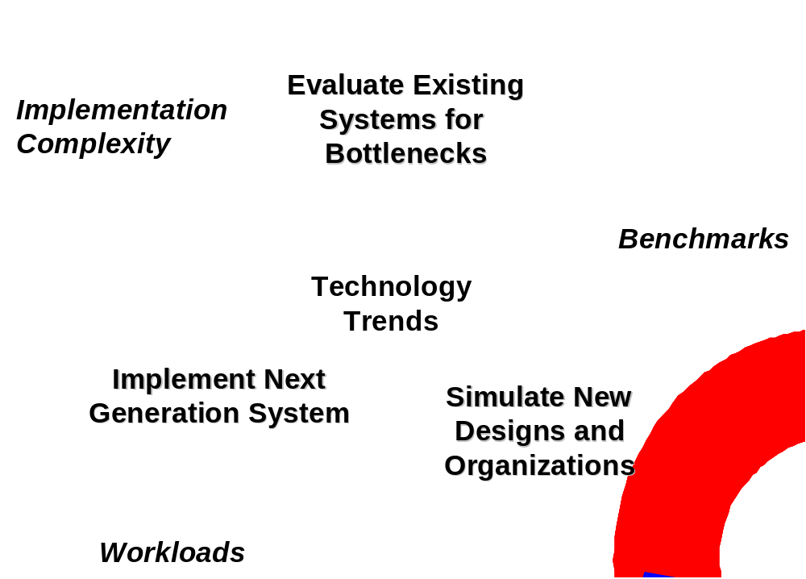
The Computer Designer’s Job
L1-<number>

Slide 7
Computer Architecture Evolution
Computer Architecture:
Functional operation of the individual HW units within a computer system, and the flow of information and control among them.
Architecting is an iterative process:
  Searching the space of possible designs
  At all levels of computer systems
  Find the best tradeoff for performance/cost
Computer Architecture Courses:
1950s to 1960s: Computer Arithmetic
1970s to mid 1980s: Instruction set architecture, especially ISAs appropriate for compilers
1990s: Design of CPU, memory system, I/O system,
multiprocessors
2000’s: 1990’s plus advanced concepts
L1-<number>

Slide 8
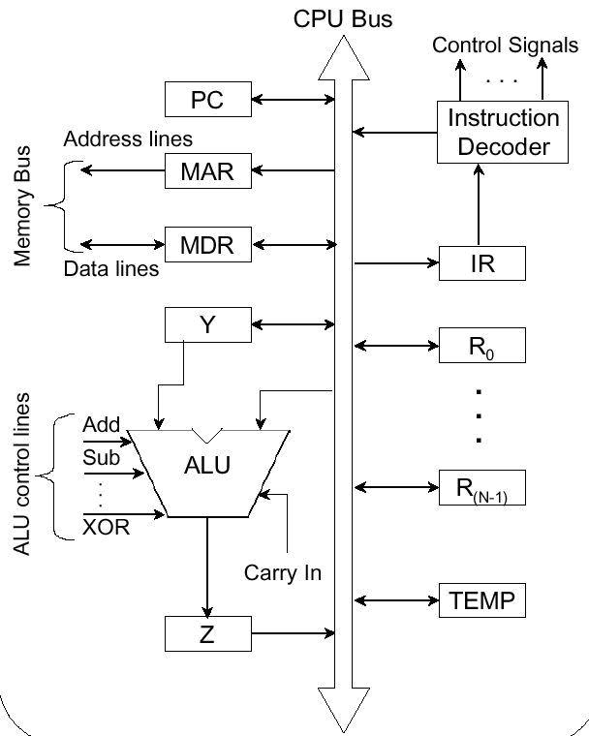
Basic Computer Architecture
MEMORY
V
O
N
N
E
U
M
A
N
N
A
R
C
H
I
T
E
C
T
U
R
E
Control
Unit
L1-<number>

Slide 9
Basic Computer Architecture
MEMORY
V
O
N
N
E
U
M
A
N
N
A
R
C
H
I
T
E
C
T
U
R
E
Control
Unit
L1-<number>

Slide 10
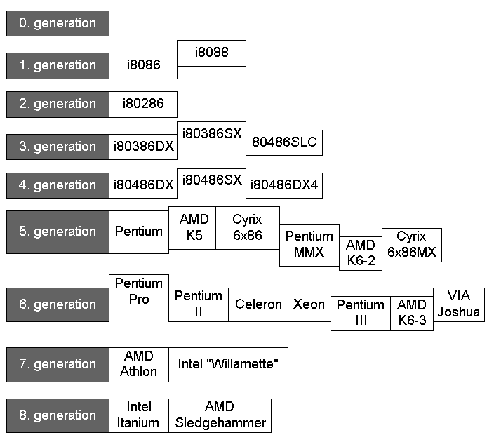
Partial Evolution of the Intel Microprocessor Line
i4004
i8008
i8080
L1-<number>
Notes:
9th generation intel (i9) Cannon lake has been due for over 2 years.

Slide 11
Architecture Evolution
It’s very difficult to make an accurate prediction, especially about the future.
Niels Bohr
Architecture Trends in the 1990s:
Performance was the ultimate metric
Transistors were a limiting factor – how many could you pack on-chip??
So:
Large on-chip caches
Prefetching hardware
Speculative Execution
Special-purpose instructions
Branch prediction
L1-<number>

Slide 12
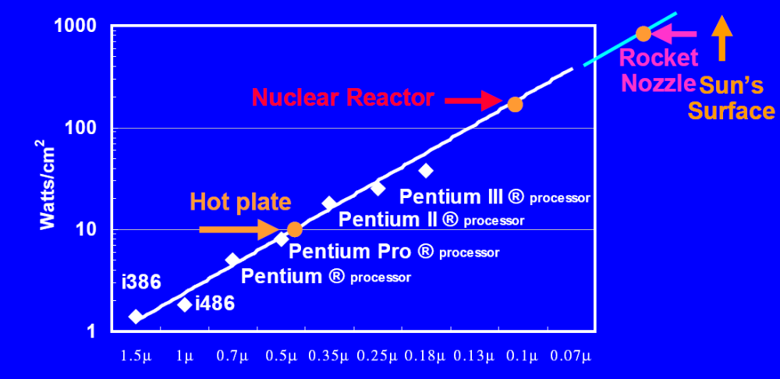
We Have Hit the Wall for Single CPU Chips!
Single core performance
Memory
Complexity
Power, temperature
Noise (Schottky, Johnson, etc.)
L1-<number>

Slide 13
We Have Hit the Wall for Single CPU Chips!
Intel i9-9900K (64 watts/cm²)*
* Mulitcore Architecture 14nm 6 cores +24 GPU
elements
Single core performance
Memory
Complexity
Power, temperature
Noise (Schottky, Johnson, etc.)
L1-<number>

Slide 14
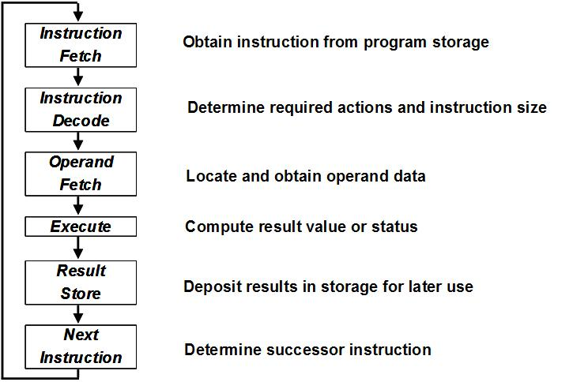
Designing a Computer Simulator
For the basic machine, to execute instructions we will probably need a few functional units. The basic instruction execution cycle looks something like this:
L1-<number>

Slide 15
Discussion
Obtain Instruction from program storage
The Program Counter (PC) contains the address of the next instruction to be executed. This address should be transferred to the Memory Address Register (MAR). This takes 1 cycle.
MAR <- PC
On the next cycle, the Memory Control Unit (MCU) uses the address in the MAR to fetch a word from memory. This fetch occurs in one cycle. The word fetched from memory is placed in the Memory Buffer Register (MBR).
Read signal
MBR <- MEM[MAR]
L1-<number>

Slide 16
Discussion
2. Determine operation required
The contents of the Memory Buffer Register (MBR) are moved to the Instruction Register (IR). This takes 1 cycle.
So, 3 cycles to get a word from memory.
IR <- MBR
In 1 cycle process the instruction and use it to set several flags:
  a. extract the opcode from the IR
  b. determine the class of opcode: determines the functional unit that will be used to execute the instruction
  c. set internal flags based on opcode
The above are done in parallel in the decoding logic of the processor.
For example, if the instruction is an LDR:
Move the target register from the IR to the Register Select 1
L1-<number>

Slide 17
Discussion
3. Locate and fetch operand data
Using the class of operation, fetch the operand:
  if it is located in memory,
  or extract it from the instruction, if it is immediate,
  or fetch from the stack
In one cycle, move the first operand address from the IR to the Internal Address Register IAR IAR <- IR(address field)
If the operand is indexed, in 1 cycle add the contents of the
specified index register to the IAR IAR<- IAR + X(index field)
c. In 1 cycle, move the contents of the IAR to the MAR
MAR <- IR
In one cycle fetch the contents of the word in memory
specified by the MAR into the MBR.
Read
L1-<number>

Slide 18
Discussion
4. Execute the operation
Depending on the operation code, execute the operation.
Some examples, but you need to think through how this will be done for all instructions.
[NOTE: If you have problems, ask questions!]
LDR: In one cycle, move the data from the MBR to an Internal Result Register (IRR)
STR: Move the contents of the specified register using Register Select 1 to the IRR.
ADDI: In one cycle, using the Register Select 1,
add the contents of the Immediate portion of the IR
to the contents of the specified register using an internal adder.
L1-<number>

Slide 19
Discussion
5. Deposit Results
In 1 cycle, move the contents of the IRR to:
a. If target = register, use Register Select 1 to store IRR contents into the specified register
b. If target = memory, such as a STR, move contents of IRR to MBR. On the next cycle, move contents of MBR to memory using address in MAR.
Q? How did we know where to move the word into memory?
Q? What is an effective address?
L1-<number>

Slide 20
Discussion
6. Determine Next Instruction
In most cases, we execute instructions sequentially, so we just increment the PC by the number of bytes/words based on machine addressing scheme
Q? What is the PC increment given the brief description of the machine?
But, if it is a branch instruction, then we have to replace the contents of the PC by a different address.
L1-<number>

Slide 21
Discussion
6. Determine Next Instruction
In most cases, we execute instructions sequentially, so we just increment the PC by the number of bytes/words based on machine addressing scheme
Q? What is the PC increment given the brief description of the machine?
But, if it is a branch instruction, then we have to replace the contents of the PC by a different address.
L1-<number>

